Slide 1

WELCOME!
To Our
Homebuyer Education Class
CITY OF GASTONIA
Notes:
https://youtu.be/X-yJhGcS7U4?si=q1VJBVk2Uu4jXXUt

Slide 2

INTRODUCTION
HOUSING AND COMMUNITY ENGAGEMENT DEPARTMENT
Lauretta Gordon
HUD Counselor ID-TVM492
Jeannette Salce
HUD Counselor ID-SLRJ91
Kenny Gehrig
HUD Counselor ID-P9A6CU
HOMEBUYER EDUCATION CLASS
Notes:
Gave my name and introduce Nancy.
Ask each one of them the
Ask them those questions
1. Name
2. Where are you in the home buying process?
3. Something you are excited about?
4. Something you are worried about?

Slide 3

The City of Gastonia – HOUSING AND COMMUNITY ENGAGEMENT DEPARTMENT provides Housing and Pre-purchase counseling. As a client, you are not obligated to receive, purchase, or utilize any other services offered by the City of Gastonia, HOUSING AND COMMUNITY ENGAGEMENT DEPARTMENT to receive housing counseling services.
Any information provided is for informational purposes only.
Notes:
Gave my name and introduce Nancy.
Ask each one of them the
Ask them those questions
1. Name
2. Where are you in the home buying process?
3. Something you are excited about?
4. Something you are worried about?

Slide 4

KNOWING
THE BASICS
Renting vs Buying
HOMEBUYER EDUCATION CLASS
Renting: freedom to move, no investment risks. Not responsible for repairs.
Buying: Stable housing cost, building equity, on going maintenance/repair costs.
Notes:
Renting: fluctuation of rent, low to no maintenance.
Buying: pets, yard, décor, tax savings, yard work, things will break and you will have to fix them,

Slide 5

HOMEBUYER EDUCATION CLASS
Notes:
Renting: fluctuation of rent, low to no maintenance.
Buying: pets, yard, décor, tax savings, yard work, things will break and you will have to fix them,

Slide 6
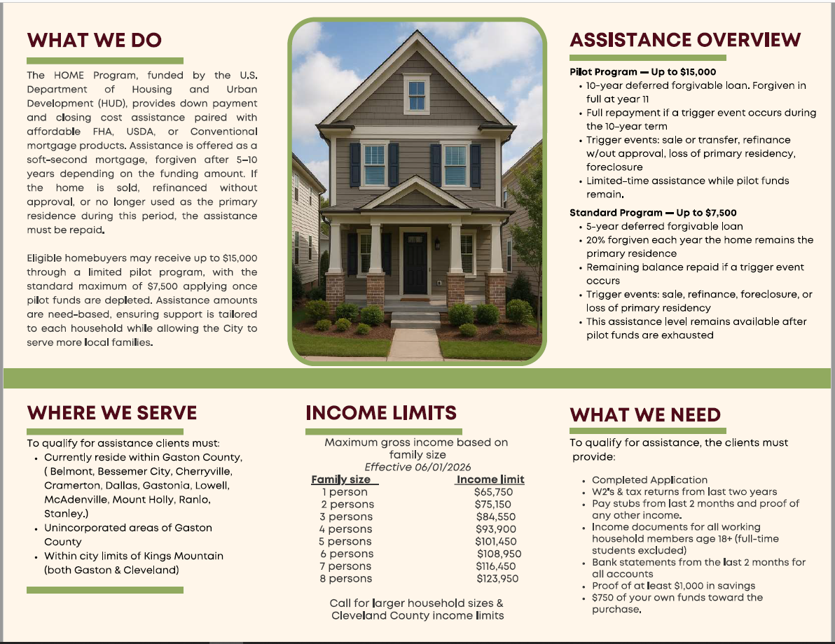
HOMEBUYER EDUCATION CLASS
Notes:
Renting: fluctuation of rent, low to no maintenance.
Buying: pets, yard, décor, tax savings, yard work, things will break and you will have to fix them,

Slide 7



Getting organized
File Maintenance
•How can you get organized?
Category
Home, insurance, utilities, car...
•Detailed Category
•Monthly
HOMEBUYER EDUCATION CLASS
Notes:
How ID theft happens?
1. Dumpster diving - rummaging through trash
2. Stealing wallets, purses, or mail
3. Stealing processed credit/debit card
numbers
4. Stealing employer records
5. Obtaining credit report
How to detect if you're a victim?
1. Monitor financial balances
2. Denial of credit for no reason
3. Calls from debt collectors
4. Failing to receive bills
5. Receiving credit cards for which you did not apply

Slide 8



Be in the KNOW with ID Theft
  How do you think ID theft occurs?
  How to detect if you're a victim?
  What to do if you’re a victim?
  Can identity theft affect a first- time homebuyer?
HOMEBUYER EDUCATION CLASS
Notes:
How ID theft happens?
1. Dumpster diving - rummaging through trash
2. Stealing wallets, purses, or mail
3. Stealing processed credit/debit card
numbers
4. Stealing employer records
5. Obtaining credit report
How to detect if you're a victim?
1. Monitor financial balances
2. Denial of credit for no reason
3. Calls from debt collectors
4. Failing to receive bills
5. Receiving credit cards for which you did not apply

Slide 9


DEVELOPING A BUDGET
  A budget/spending plan is about giving every dollar a purpose. Knowing where your $ went.
  What comes to mind when you think of a budget/spending plan?
Notes:
Budget:
IS
Telling your money where you want it to go…a way to plan how you will spend your income on paper
Lays out your income and expenses as precisely as possible
IS NOT
Restrictive (keep you from having things you WANT!)
Budgets fail when you slash

Slide 10

ADJUST YOUR BUDGET ATTITUDE
It is important to see a budget as a guide, to help spend responsibly and ENJOY life.
Let's look at some of the biggest expenses most of us have:
  Mortgage/rent payments
  Utilities
  Food
  Transportation
  Clothing
  Entertainment
How will cutting these things impact your quality of life?

Slide 11
Managing your money
Steps to establishing a Budget/Spending Plan
Step 1: Estimate your income
  Salary
  Child Support
  Part-time job
  Side Jobs ex: nails, hair, auto repairs
The key is to spend less than you make!!!
Step 2: Identify your Expenses
  Need a copy of your bank statements
  Credit card statements
  Cash receipts, etc...
Notes:
You need to begin keeping detailed records of all expenses, down to the last penny. It will really open your eyes to see where your money is going!

Slide 12


Step 4: Evaluate your budget and set goals
Step 3: Do the Math
  Get everything in writing, is one of the best ways to make it real.
  Find your spending leaks and Plug them! A tiny leak sinks big ships.
  Stick with it.
  How much are you currently paying in rent?
  What kind of things can you do to change?
  Future expenses?
  Emergency account (6-12 months)
Notes:
Get everything in writing, that’s the best way to keep your promise of budgeting.
Find your spending leaks and PLUG them!
Nails design, etc... Small sacrifices add up to significant savings.
Stick with it, the first year is the worst but then it should feel more comfortable as time goes by.
How much CAN you spend and how much do you WANT to spend?
Stop “Living Out Loud!”
Comparison shopping, coupons, impulse spending.

Slide 13

IDENTIFY YOUR NEEDS VS. YOUR WANTS
Needs: something necessary to live and function.
Shelter-rent/house payment
Water-to live
Electricity-to stay cool or warm
Food-to live
Car-to go to work
Wants: something that can improve your quality of life.
Eating out
Shopping
Hair and Nails
Online games
Tattoos
Entertainment
Where should your money go?
Smart strategies that work!
Notes:
Wants are like:
Designer clothing
Lattes
Eating out
Cable
Entertainment
Trips to the beach
Target runs.
Needs are like:
Mortgage Payment/Rent
Utilities
Health Insurance
Car Payment – you have control
Food – not including eating out

Slide 14

SIMPLE SAVINGS STRATEGIES
  Determine what is the goal for the money.
    House fund?
    Christmas fund?
    Birthday fund?
  What barriers might keep you from reaching your goals?
  Take control of your life and your spending, no one is going to do it for you!
Notes:
Did you know that
More than 40% of Americans experienced an unexpected emergency expense in the past year that they couldn’t cover. Pay yourself first!

Slide 15
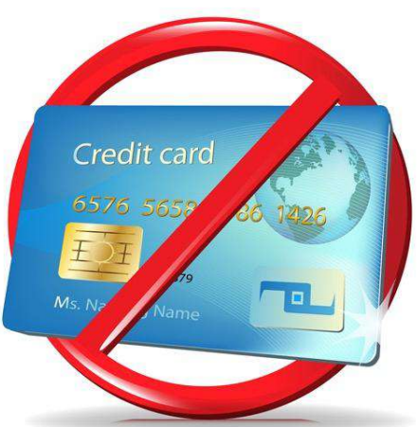

TIPS TO BECOME DEBT FREE
  Start controlling your finances
  Track expenditures
  Trim spending
  Increase monthly payments on debts
  Plan for recurring expenses
  Don’t borrow any more money
  Be patient
Notes:
Start controlling your finances – know how much you owe
Track expenditures – 30 days
Trim spending – Cash only, no credit cards
Increase monthly payments on debts
Plan for recurring expenses – car tags
Don’t borrow any more money – no lines of credit
Don’t borrow from your retirement fund – penalties
Be patient – changing habits are hard

Slide 16

  How satisfied am I with my spending behavior?
  Am I willing to make changes?
  What changes would I need to make to buy my home?
  What is the most important thing I WILL change?
  What is the first step I could take to reach my goal of homeownership?
SELF REFLECTION
Notes:
Reasons why you need a budget:
It helps you reach your goals
It helps you make choices about how you use your financial resources

Slide 17





The Four C(s) of Credit
CAPITAL - Valuable Assets
COLLATERAL
iSIS
CHARACTER - Will you repay?
CAPACITY -
Can you Repay?
Notes:
1.
Do you pay your bills on time?
Do you have a good credit report?
How long have you lived at your present address/been on your present job?
2.
Do you have a savings account?
3.
Do you have a steady job?
What are your current living expenses?
How many dependents do you have?
4.
Is the property value worth it?

Slide 18
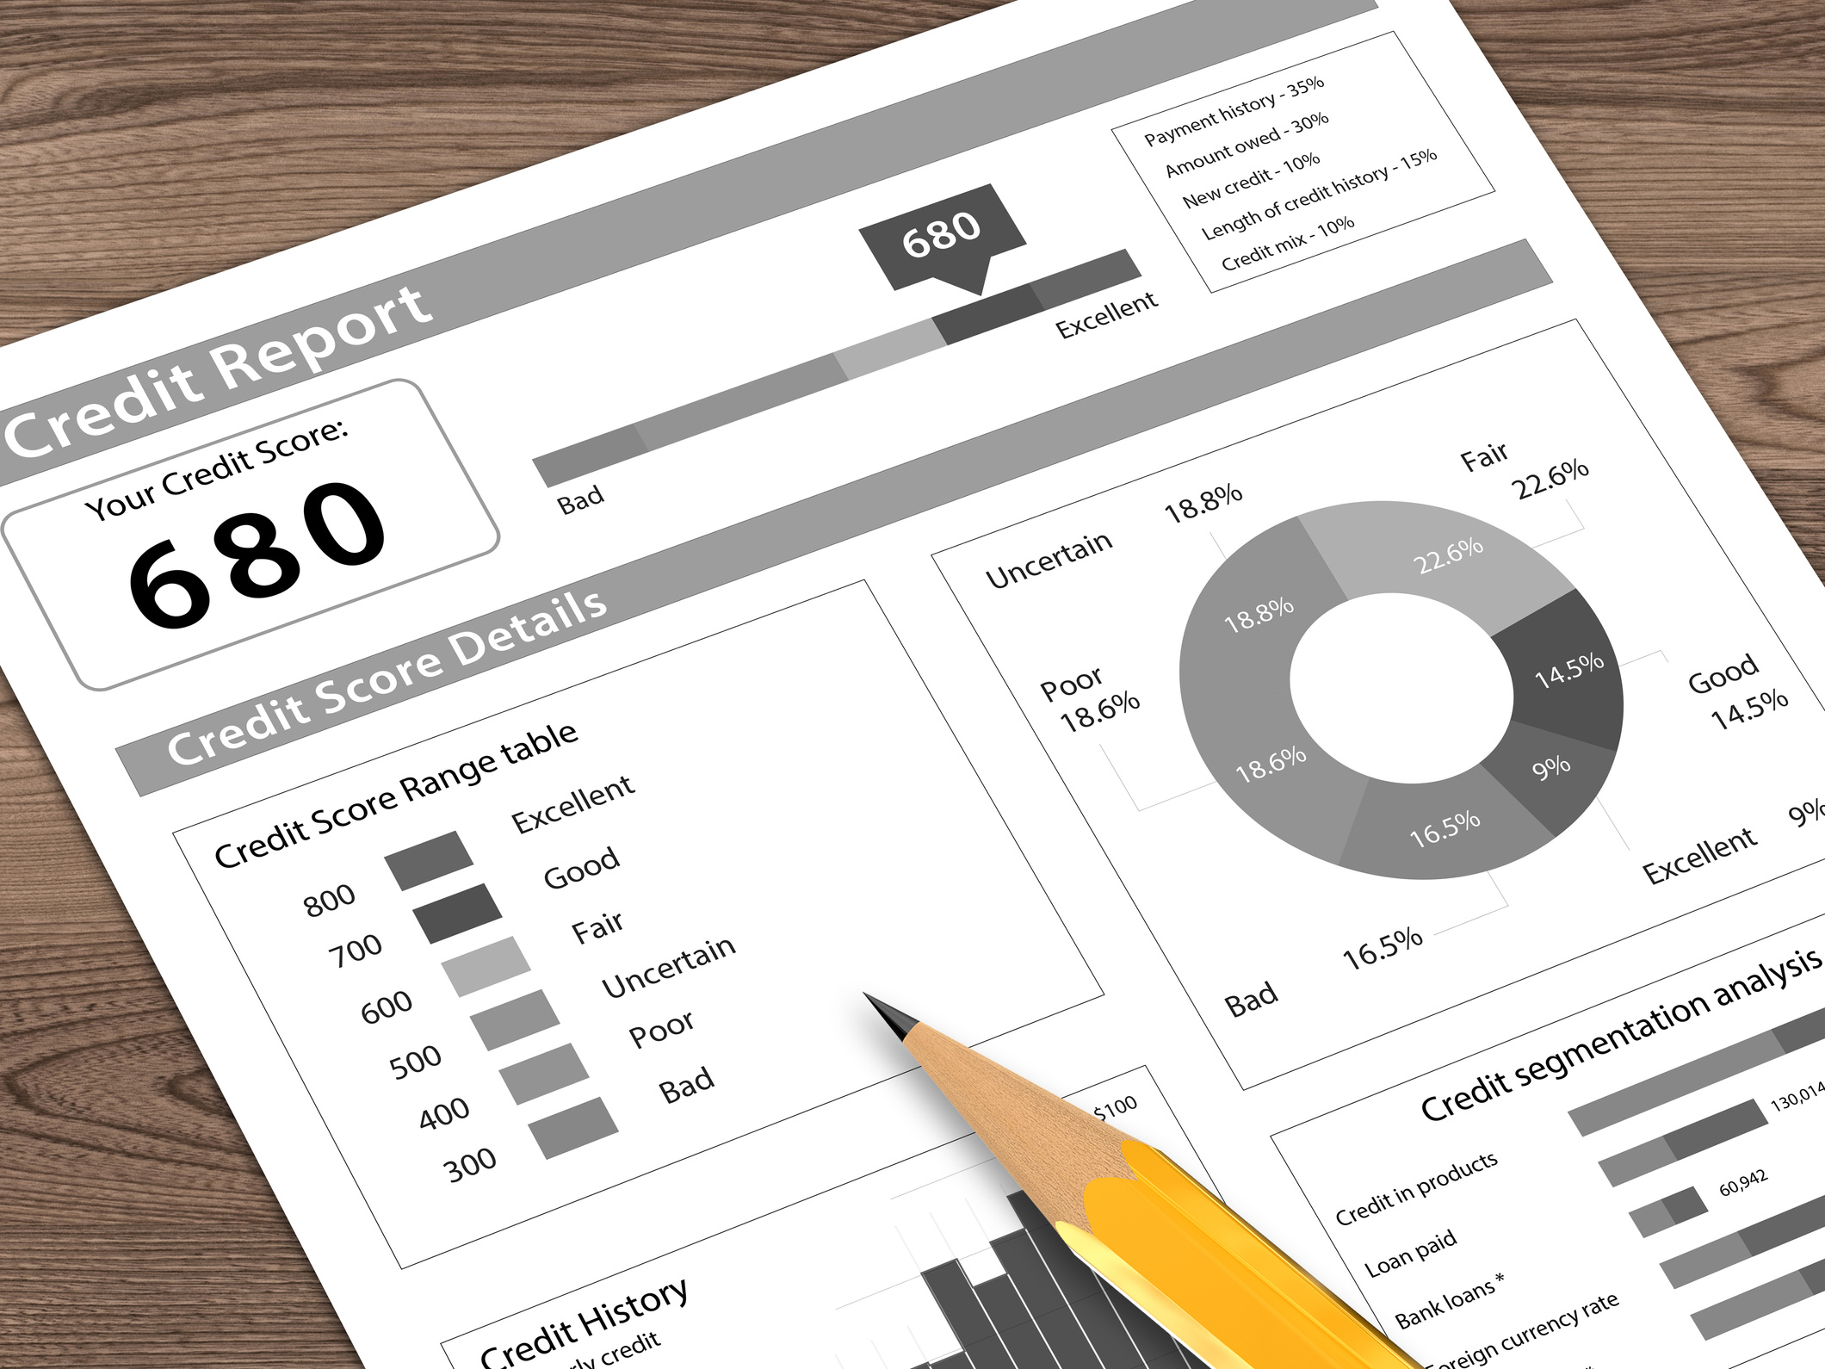
CREDIT REPORT
Notes:
What is it?
A credit report is YOUR reputation of paying both past and present credit accounts.
Contains your credit history for the past seven years.

Slide 19




UNDERSTANDING YOUR CREDIT REPORT
There are three major credit reporting Bureaus.
Equifax
Experian
Transunion
Did you know you can pull your report once a year for free?
(877) 322-8228
PO Box 105281, Atlanta, GA 30348-5281
www.annualcreditreport.com

Slide 20
UNDERSTANDING YOUR CREDIT REPORT

Slide 21
KNOW YOUR REPORT
What are the components of the Credit Report?
Personal Information, Credit History, Inquiries, etc..
FICO, why is it important?
  used by lenders to determine whether to extend credit or service.
  an estimate of your credit risk based on a snapshot of your credit at a particular point in time
  The higher the score the lower the risk.
FICO, what is it?
  a credit scoring system developed by Fair Isaacs and scores range from 300 to 850.
Notes:
Credit Score
Collection Accounts
Courthouse/Public Records
Who else use the credit scores
insurance companies,
utility companies, landlords, etc.

Slide 22
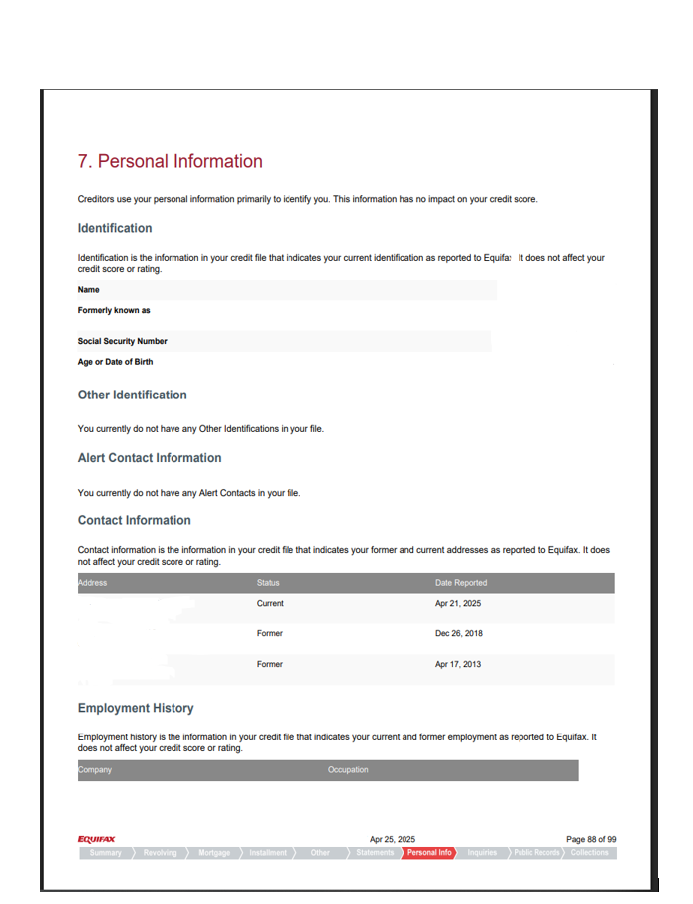
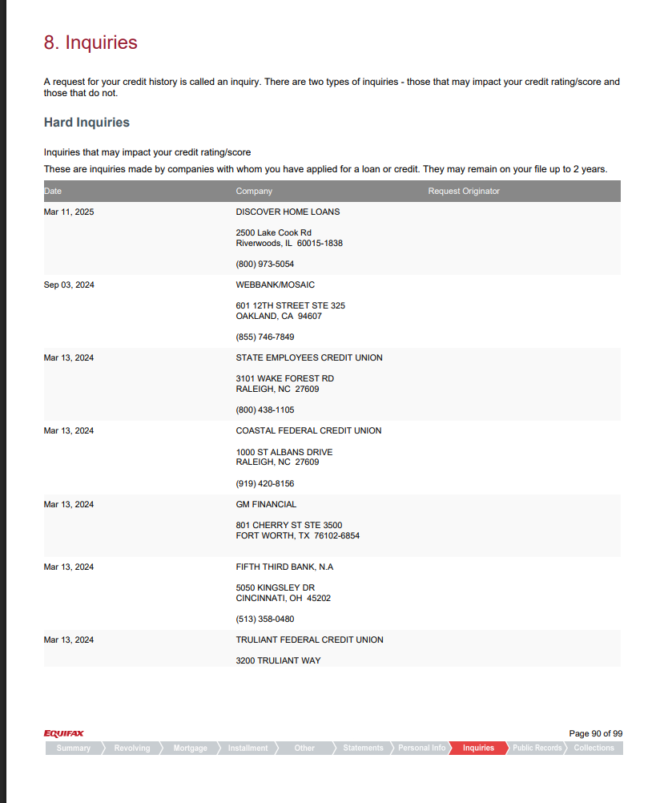
KNO ORT
Notes:
Credit Score
Collection Accounts
Courthouse/Public Records
Who else use the credit scores
insurance companies,
utility companies, landlords, etc.

Slide 23
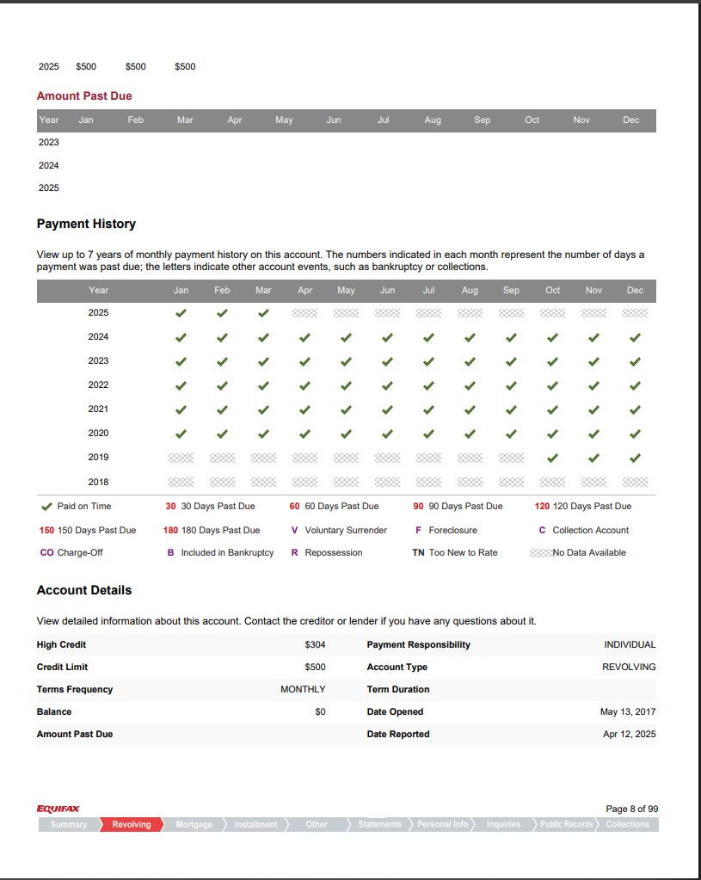
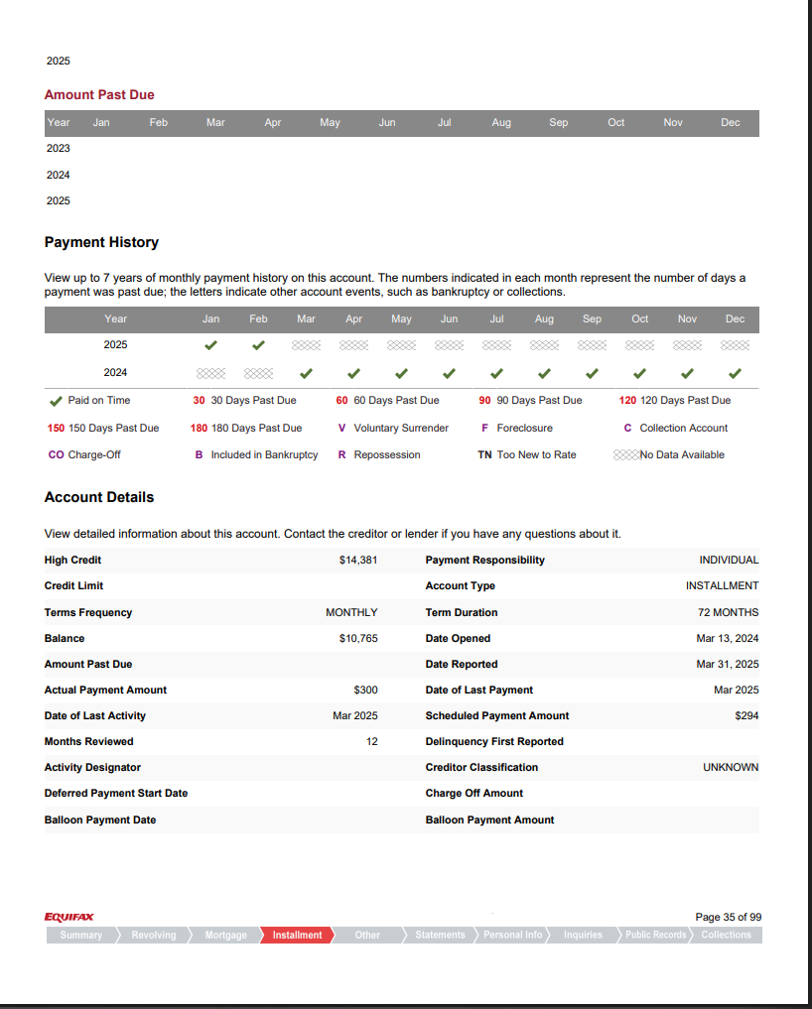
KNOW YOUR REPORT
Notes:
Credit Score
Collection Accounts
Courthouse/Public Records
Who else use the credit scores
insurance companies,
utility companies, landlords, etc.

Slide 24


HOW A FICO SCORE IS
DETERMINED
Payment History: 35% or 297.5 points.
Amounts Owed: 30% or 255 points.
Length of Credit History: 15% or 127.5 points.
New Credit: 10% or 85 points.
Types of Credit Used: 10% or 85 points.
35%
30%
10%
15%
10%

Slide 25

The Good and BAD of USING CREDIT
  Credit is only BAD if it is not used properly. Ex: To Purchase a cheeseburger!
  Such as paying interest every month that you can't afford at 29.99% - 34.99% and paying fees to carry a credit card.
  Get goods and services before paying.
  Helps to manage emergencies.
Learn to use your debts is key!

Slide 26



Understanding your credit report: Inquiries
  Usually have a small impact
  Some inquiries are ignored completely
  Rate Shopping - Within a short period of time (30 days)
Notes:
when you or your employer pull your own report,
pre-approved” credit offers or for review

Slide 27

DEBT MANAGEMENT
It takes time and there is no quick fix!
  ONLY buy what you need
  Pay your bills on time
  Get current and stay current
  Keep balances low on revolving accounts
  Pay off debt – but don’t close accounts
  Don’t open new accounts that you don’t need

Slide 28


Slide 29


MORTGAGES
Where to start?
How many types are there?

Slide 30


Conventional
Custom Programs for 1st Time Home Buyers
VA
  Low or no mortgage insurance (MI).
  20% or more down payment.
  Lower interest rate
  Low or No PMI
  Lower application fee
  Designed for Veterans.
USDA
FHA
  Written for people buying in rural areas.
  Offers lower down payment options, 3.5 to 10% or more.
  Has a Mortgage Insurance Premium (MIP)

Slide 31
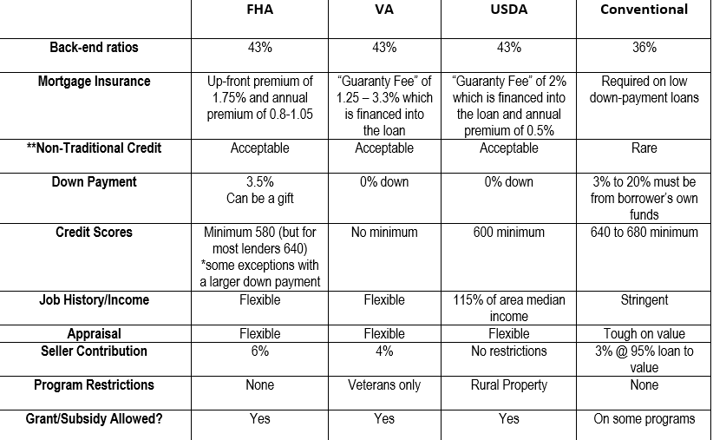
LOAN COMPARISONS
KNOW BEFORE YOU GO!

Slide 32

APPLYING FOR A MORTGAGE
  Know the difference between pre-approval and pre-qualified
  What paperwork will they need?
  Commonly used mortgage terms:
*Interest Rate - fixed or adjustable
*Down Payment
*Fees
*Debt to income ratios
*Private Mortgage Insurance (PMI)
*Mortgage Insurance Premium (MIP)
*Processing - Underwriting - Appraisal
*Commitment letter - Loan Conditions
*APR - Annual Percentage Rage
Notes:
Know your potential payments, know your price range, and improve the strength of your offer.
Paperwork: Taxes, W2, bank statements, some places ask for utility bills and credit card statements.
APR: Annual Percentage Rate includes all the fees that are wrapped back into your loan…the closer that number is to your actual interest rate the better

Slide 33
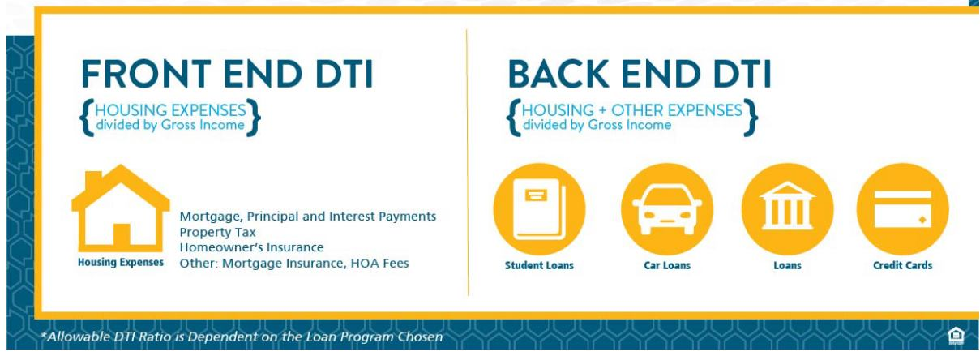
DTI (debt to income )example
Gross monthly income = $3000
Monthly housing expenses= $900
Other monthly debts = $300
Housing Ratio (Front)
$900/$3000 = .30 or 30%
Debt Ratio (Back)
$900 + $300 =$1,200/$3000 = .40 or 40%

Slide 34
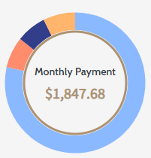
Monthly Payment
$1,847.68/month for 30 years
Principal & Interest
$1,452.02
Property Taxes
$131.25
Homeowners Insurance
$128.00
Private Mortgage Insurance (PMI)
$136.41
Mortgage Size$218,250.00
Home Price
$225,000
30 Year Loan Term
6.75% Interest Rate
3% Down Payment Amount
$6,750

Slide 35


FAIR
HOUSING
What is the Fair Housing Act?
Title VIII of the Civil Rights Act of 1968, with the Fair Housing Authority Amendments Act of 1988, is called the Fair Housing Act. These combined laws make it illegal to discriminate in housing sales or rentals or in housing lending and insurance based on…
Race Color Sex National Origin
Family Status Religion Disability
Notes:
If you feel any help with that, we have brochures and the website for reference.
There is NC legal Aid for the housing process
NC Human Relations Services
Gaston County Mediation Center:
Fair Housing Line

Slide 36
FAIR
HOUSING
Refusal to rent or sell housing
Refusal to negotiate for housing
Set different terms, conditions, or privileges for rental
Falsely deny that housing is available for inspection or rental
Impose different sales prices or rental charges for the rental of a dwelling
Use different qualification criteria or applications, or rental standards.
Evict a tenant or guest
Make the unit unlivable
Fail or delay performance of maintenance or repairs. Etc…
In the Sale and or Rental of Housing:
It is illegal to take any of the following actions because of race, color, religion, sex (including gender identity and sexual orientation), disability, family status, or national origin:
Notes:
If you feel any help with that, we have brochures and the website for reference.
There is NC legal Aid for the housing process
NC Human Relations Services
Gaston County Mediation Center:
Fair Housing Line

Slide 37
FAIR
HOUSING
Do you feel you’re being discriminated against?
Legal Aid Fair Housing (855) 797-3247
Fair Housing NC (800) 440-8091
Notes:
If you feel any help with that, we have brochures and the website for reference.
There is NC legal Aid for the housing process
NC Human Relations Services
Gaston County Mediation Center:
Fair Housing Line

Slide 38


PREDATORY LENDING
  High-pressure sales or deceptive sales tactics
  Preys on lack of information or lack of credit confidence
  Higher interest rates, points, fees
  Advertised as “last option” loans
  Credit problems? No problem
  When everyone says no, we say yes!
  Name a few of these companies

Slide 39






WHOM DO PREDATORY LENDERS TARGET?
  People “desperate” for help
  Poor people
  Minorities
  Single mothers
  People with low credit scores
  Elderly
  People uneducated about finances

Slide 40


YOUR REALTOR'S ROLE
To help you make an informed decision when purchasing a home.
May know what is coming into the area you are purchasing in.
Notes:
What can your realtor do?
Show you houses
Negotiate on your behalf
You want a professional to help you look and negotiate

Slide 41
What a REALTOR® Is Legally Obligated to Do
01
Loyalty & Confidentiality
04
Professionalism
Acts exclusively in your best interest and keeps all personal information confidential.
Provides access to MLS listings, cooperates with other brokers, follows the REALTOR® Code of Ethics.
02
Care & Diligence
05
Guidance & Support
Discloses all known material facts about properties and protects you from foreseeable risks.
Connects you with trusted lenders, attorneys, inspectors, and coordinates the entire process.
03
Communication & Negotiation
Explains contracts, presents and negotiates offers on your behalf, keeps you updated.
70% of all real estate lawsuits involve unrepresented buyers — your REALTOR® protects you.
Notes:
Emphasize: these are fiduciary duties — legal obligations, not just good intentions. A REALTOR® must put your interests above their own. Walk through each duty briefly.

Slide 42
Beyond the Legal Requirement —
What Realtors Actually Do for You
A great REALTOR® doesn't just meet the legal standard — we go further. Every decision we make puts YOUR best interest at the center.
EDUCATE
ADVISE
ADVOCATE
We make sure you understand every step.
We give you honest guidance — not just answers.
We fight for your best outcome at every turn.
Explain market conditions before you make an offer
Share comparable sales data to anchor your offer price
Negotiate purchase price, repairs and closing costs
Walk you through every contract clause in plain language
Identify red flags in inspections, disclosures and titles
Push back on seller demands that don't serve you
Ensure you know your rights, timelines and deadlines
Tell you when to walk away, even if it's hard to hear
Stay in communication with all parties on your behalf
Prepare you for what to expect — no surprises
Recommend vetted attorneys, lenders and inspectors
Represent your interests from offer to closing table
Notes:
This slide goes beyond the legal duties slide. These are the things we CHOOSE to do — educate buyers so they understand every decision, advise them with honest guidance even when it's hard, and advocate fiercely on their behalf from offer to closing. Our C.A.K.E. philosophy guides everything.

Slide 43
Know What You Must Have vs. What You Want
NEEDS
WANTS
Non-negotiables — deal-breakers if missing
Preferences — great to have, but flexible
Number of bedrooms & bathrooms
Updated kitchen or bathrooms
Location & school district
Large backyard or outdoor space
Monthly payment within budget
Garage or extra storage
Neighborhood feel and community vibe
Open floor plan
Accessibility / single story (if needed)
Move-in ready condition
Notes:
Encourage attendees to fill in the Needs vs. Wants worksheet from today's handout. Ask: what's your #1 must-have? This conversation shapes every home you'll consider.

Slide 44
Key Components of the Offer to Purchase
01
Purchase Price
02
Due Diligence Fee
What you're offering to pay — based on market analysis, not just the listing price.
Non-refundable fee paid to the seller to reserve the home while you inspect the property. Amount is negotiated.
03
Earnest Money Deposit
04
Closing Date
Good-faith deposit held in escrow. Applied to your down payment or closing cost at closing.
Target date for ownership transfer — typically 30–45 days after acceptance.
05
Seller Concessions
06
Personal Property
A negotiated contribution from the seller toward your closing costs. Reduces your out-of-pocket expenses at closing.
Items included or excluded — appliances, fixtures, and negotiated items are listed here.
Always review the Offer to Purchase contract with your attorney before signing.
Notes:
The NC Offer to Purchase is a legally binding document. Buyers should never sign without understanding every line. Your agent prepares and presents it — your attorney reviews it.

Slide 45
Understanding Your Two Deposits
DUE DILIGENCE FEE
EARNEST MONEY DEPOSIT
Paid directly to the seller
Held in escrow by a neutral third party
100% non-refundable — no exceptions
Refundable if you cancel during Due Diligence
Takes the home off the market for you
Applied to your down payment or closing costs at closing
Buys time to inspect, research and secure financing
Shows the seller you are a serious buyer
Amount is negotiated — no standard rate
Typically, 1% of the purchase price
You lose this fee if you cancel — for any reason.
Safe to recover — if you act before DD expires.
Pro Tip: During the Due Diligence period, you can exit for ANY reason and get your Earnest Money back.
Notes:
This is the slide buyers remember most. Repeat it: DD fee is gone no matter what. Earnest Money comes back to you if you cancel BEFORE the DD deadline. Both go toward your purchase if you close.

Slide 46
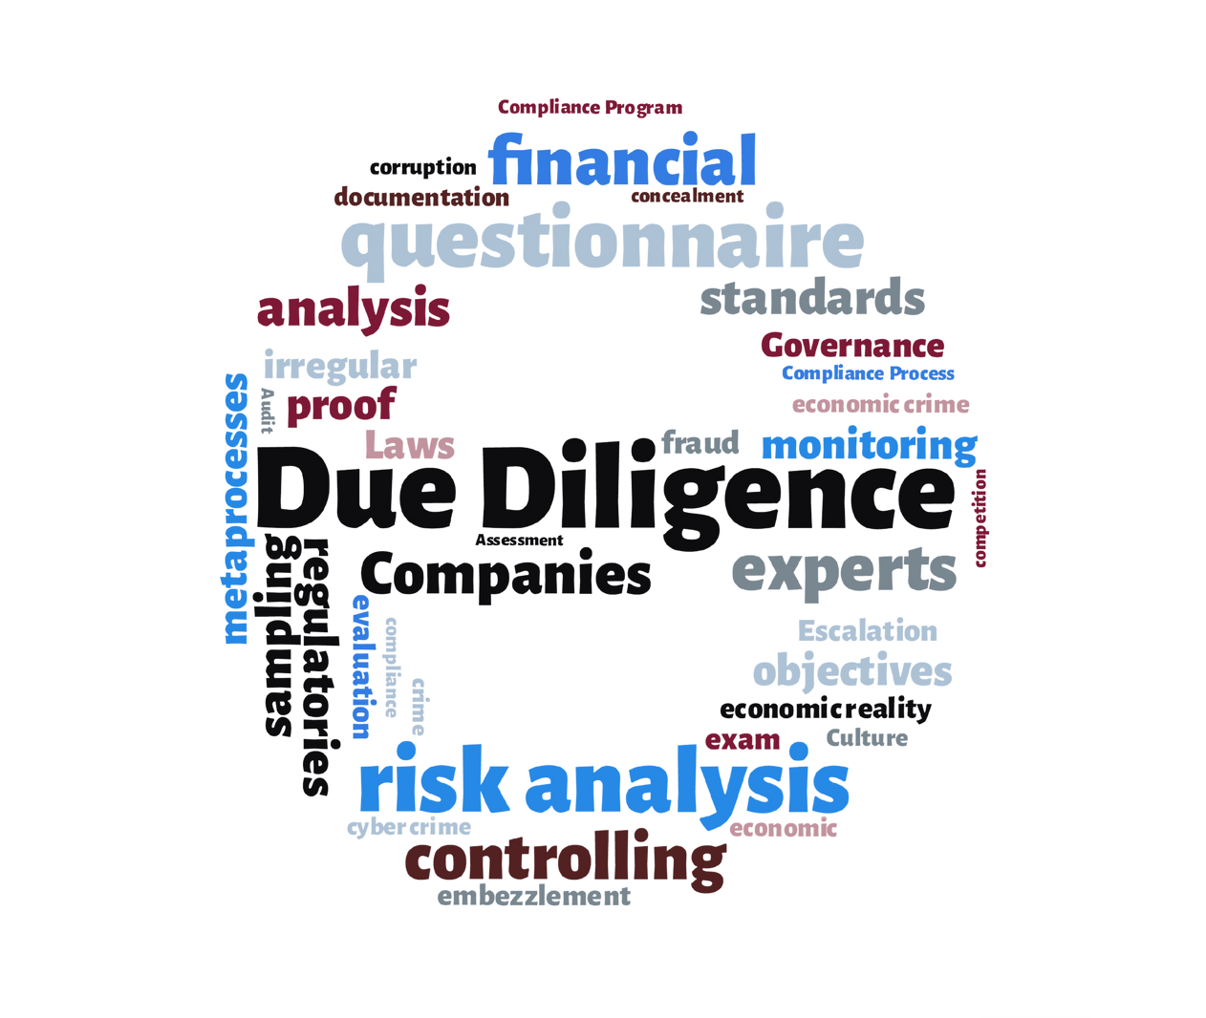
HOME INSPECTIONS
Protect yourself and your investment…
Know the difference between:
  City’s Minimum Housing Code Inspection
  Paid Home Inspection
  Pest inspection
  Radon
  Well and septic
  Termite
  Get an inspection done BEFORE you pay for an appraisal.
  Other items you MUST consider when buying a home:
Routine maintenance and repair
Major items that will have to be replaced
Notes:
Getting a professional property inspection may save you money and give you peace of mind.

Slide 47

HOME
INSPECTIONS
Go to the inspection Ask questions about
  Water
  Gas
  Furnace/AC Unit
  Breaker Box
  Hot water heater dial
  Find out where the main CUT OFF/EMERGENCY SWITCHES are
Notes:
Getting a professional property inspection may save you money and give you peace of mind.

Slide 48

HOME INSPECTION IS KEY!
•Open the crawl space door….is there water down there?
•Pull down the attic ladder…is there insulation?
•Turn on faucets and flush a toilet to test water pressure.
•Look for leaks, bulges or discoloration in walls and ceilings.
•Listen for creaks in the floorboards.
•Flip light switches.
•Check to see if all windows open, do they have screens?
•Cut on ceiling fans
•Open the breaker box

Slide 49
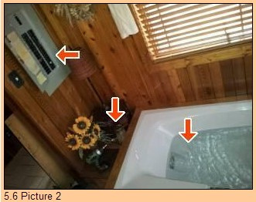
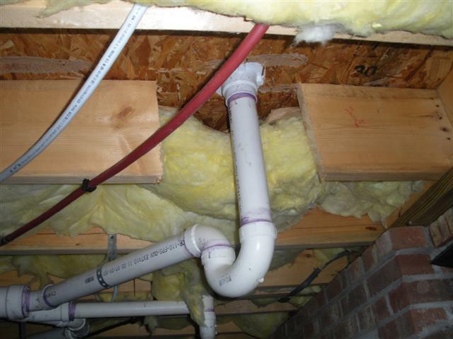
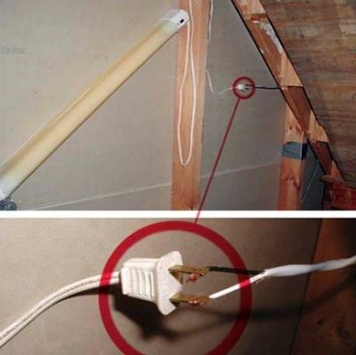
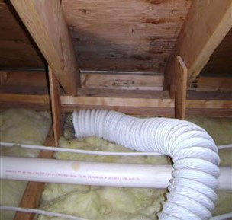

Slide 50
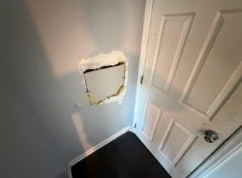
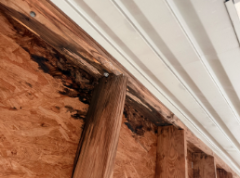
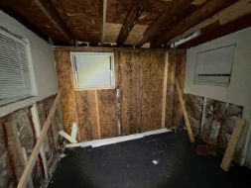
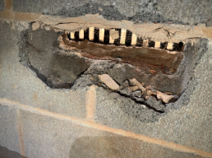





Slide 52
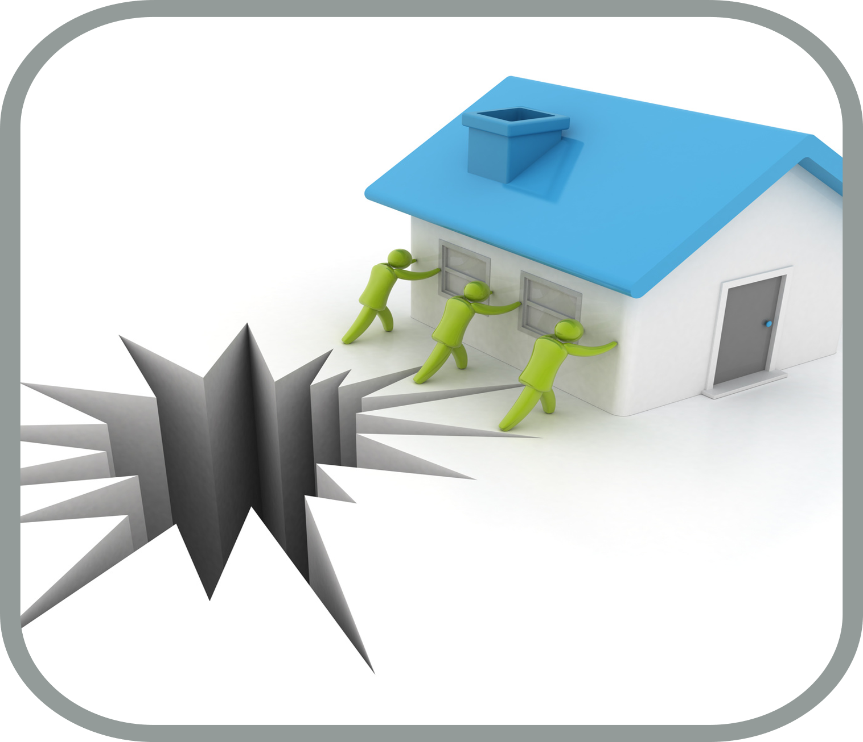
HOMEOWNER INSURANCE
Must be obtained BEFORE you can close! Call your current auto agent for a free quote.
There are two
components:
  Property Coverage
  Liability Coverage
Notes:
PC: To replace your home and belongings in case of theft, fire or other loss
LC: For claims brought by other for accidental bodily injury or damage to their property

Slide 53

HOMEOWNER INSURANCE
Property Coverage has four parts:
  Dwelling – your house
  Other detached structures – workshops or buildings
  Personal property – furnishings
  Loss of Use – costs while home is being repaired

Slide 54

HOMEOWNER INSURANCE
Liability Coverage has two parts:
  Comprehensive liability which protects you against lawsuits and claims if someone is injured on your property.
  Medical Payments - medical expenses for others.

Slide 55
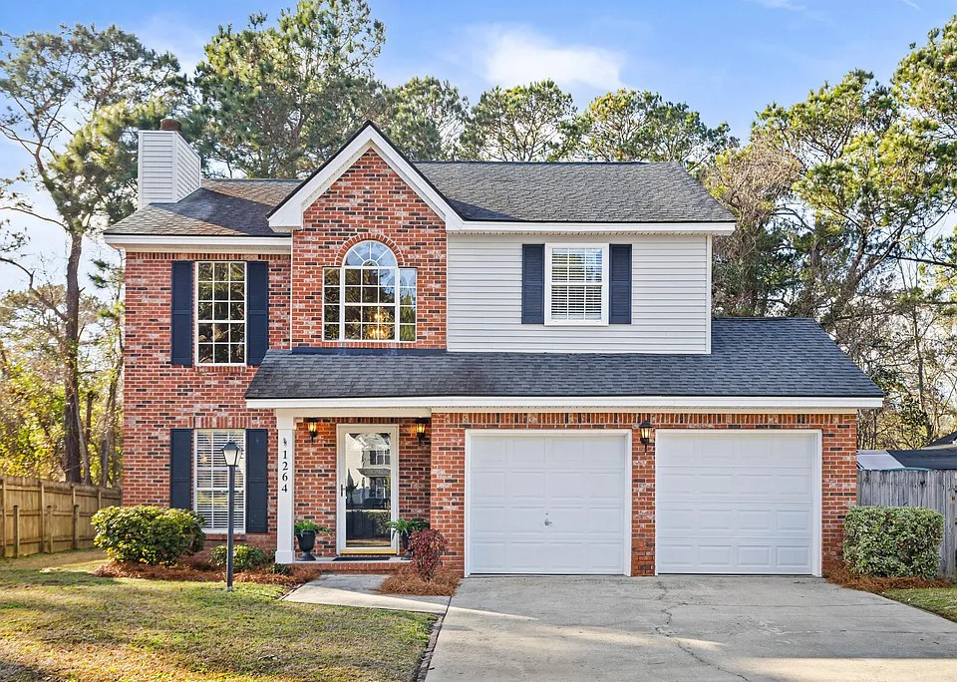
WHAT’S COVERED
VS
NOT COVERED
Covered Perils*
Fire and smoke/smudging from fire Lightning
Falling Objects (Acts of God) Sudden Explosion
Vandalism/Theft (up to certain limits) Sudden pipe bursts or steam overflow Wind/Hail/Hurricanes
Excluded Perils*
Earthquakes/Sinkholes/Ground Settling External Flooding/Landslide/Mudslide
-Peril; is the specific event or cause of damage that leads to a loss. Simply put, it is the actual danger you are insuring your property against.
Governmental Actions (Seizure or demolition by public auth.) Nuclear Hazard (Radiation or contaminated property)
War (Acts of war, undeclared war, civil unrest) Negligence/Neglect/Intentional Acts
Wear and Tear
*Coverage is awarded based on covered causes of loss. Every policy is different with different coverage and exclusions.

Slide 56
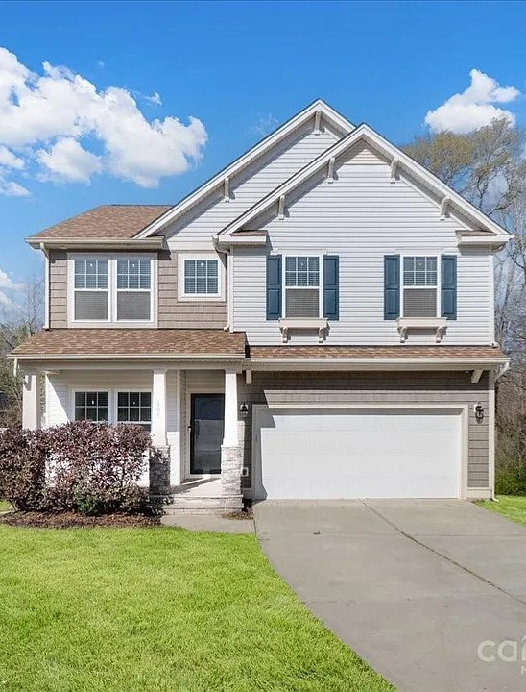
WHEN TO SEARCH FOR COVERAGE?
Private Home/System Inspections
Due Diligence Period
Shop Home Insurance
Repair/Replacement Requests to Sellers

Slide 57

RISK ASSESMENTS
3 Categories Determine Your Premium (3 P’s)
Rating Factors
“How risky” or “how likely” is this person or property going to present a claim.
Personal/Insured Rating Factors
Sex, Age Group, Financial Responsibility (Credit Based Insurance Score), Prior Claims, Marital Status, Family Size, Co-Applicants
Property/Dwelling Rating Factors
Home Age, Home SQ Footage, Materials/Construction, Roof Age/Type/Shape, Major Systems Age/Updates, Location (Urban/Rural), Fire Protection Class, Pet Breeds, Attractive Nuisances, Prior Claims from Sellers
Policy Factors
Dwelling Coverage, Deductibles, Bundled Policies, Optional coverage enhancements/endorsements

Slide 58

WAYS TO SAVE!
The Newer the Better
New home, new roof, new systems = less risk
Bundles
Same carriers for home/auto/umbrella etc
With independent agents, often times there is a “bundle” discount for having your home and auto policy with the same agent, despite different carriers.
Preventative Tech
Security systems with dispatch to authorities, even a doorbell camera. Water sensors and automatic water shut off valves
Coverage Shopping
Your agent should be proactively shopping you every year
It’s best to renew for 2-3 years with the same carrier and THEN change carriers Ensure coverage is accurate and up to date with replacement estiamtes and premiums

Slide 59

Reviewing the LOAN ESTIMATE (LE)
What is the Loan Estimate and When is it Used?
  A document provided by lenders within three business days of receiving your mortgage application.
  It details loan terms: Interest rate, Monthly payments, Total closing costs, Taxes and Insurance.
  Lenders may issue a revised Loan Estimate if changes occur to the loan.
Notes:
.

Slide 60
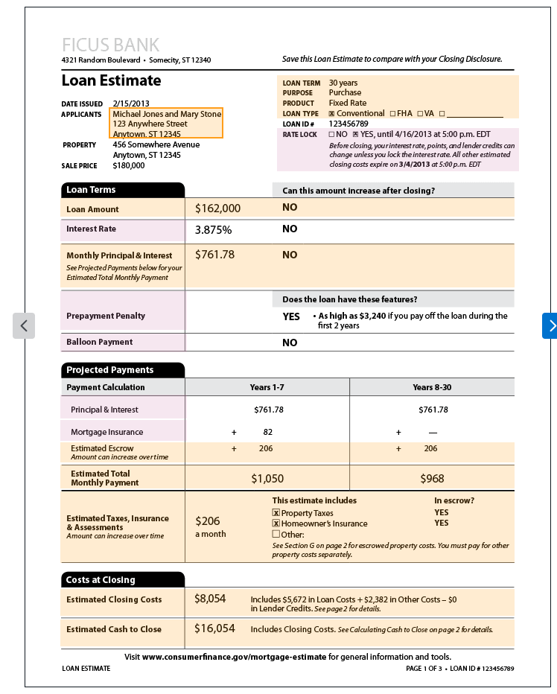
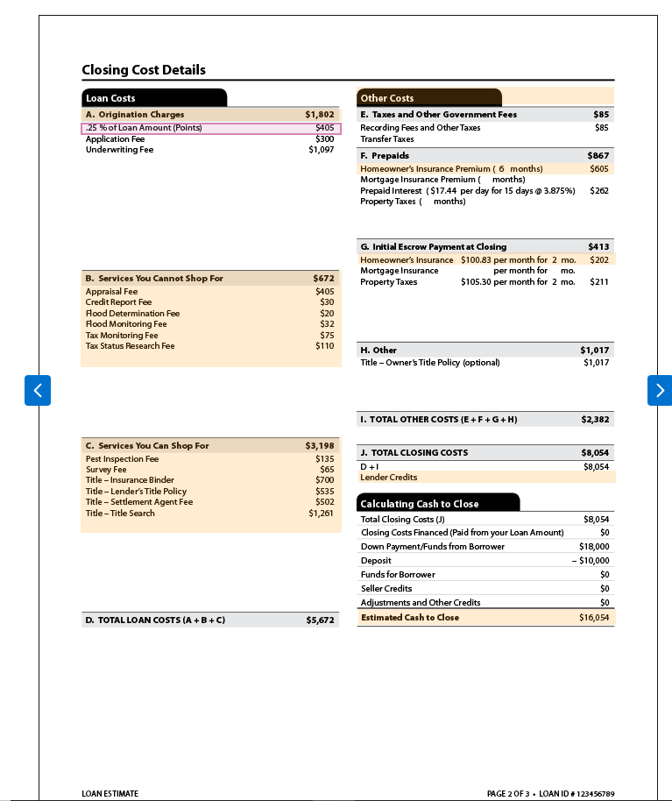
Reviewing the Loan Estimate (LE)

Slide 61
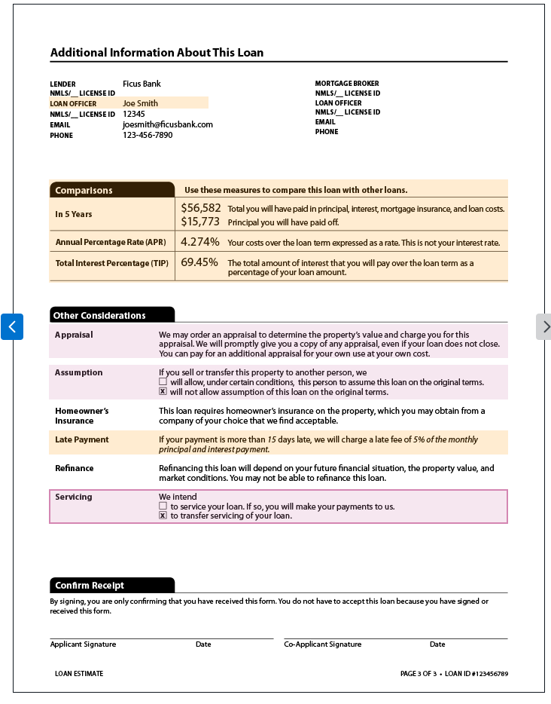
Notes:
.

Slide 62

TYPICAL BUYER EXPENSES
  Home inspections
  Surveys
  Property taxes
  Property Association Dues
  Title Search
  Title Insurance
  Hazard Insurance
  Down payment
  Lender fees
  Deed Recording
Notes:
Part of those expenses can be covered with our program funds

Slide 63
UNDERSTANDING THE CLOSING DISCLOSURE (CD)
What is the Closing Disclosure and When is it Used?
  A form used by the attorney at closing
  Itemizes all charges paid by a borrower and seller for a real estate transaction
  Gives each party a complete list of incoming and outgoing funds.
Notes:
.

Slide 64
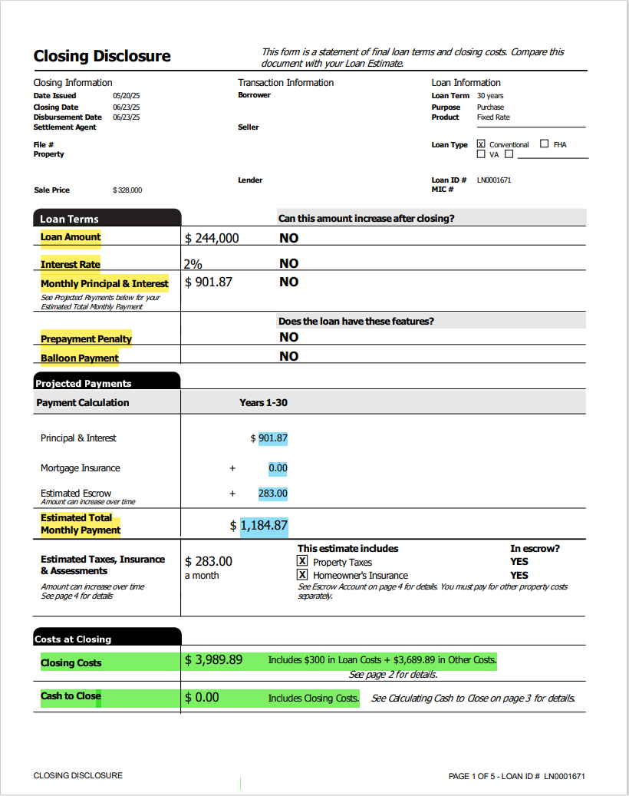
UNDERSTANDING THE CLOSING DISCLOSURE (CD)
Notes:
.

Slide 65
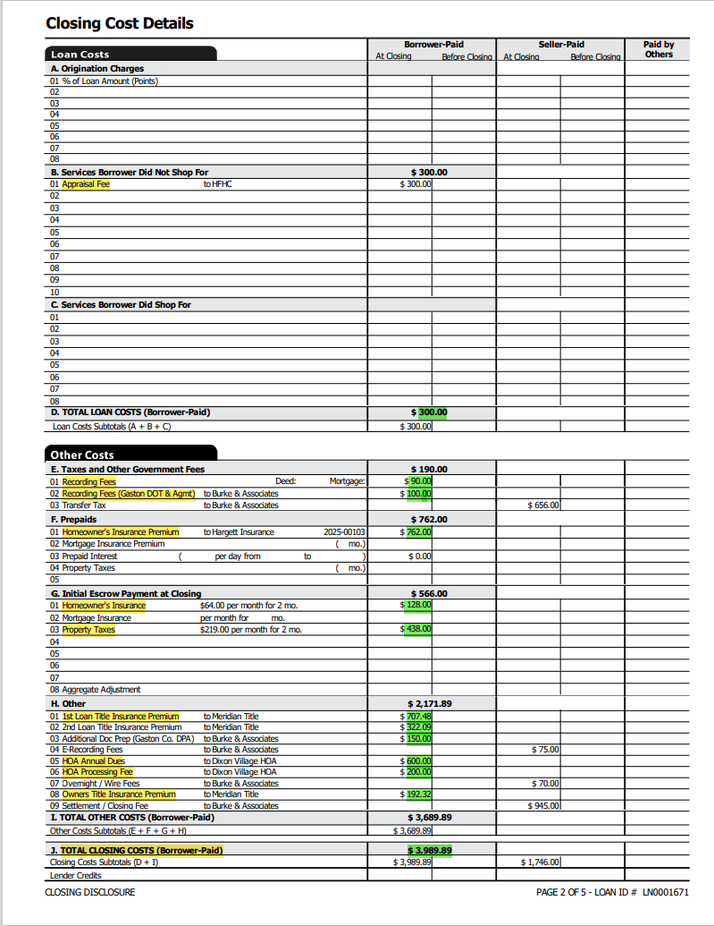
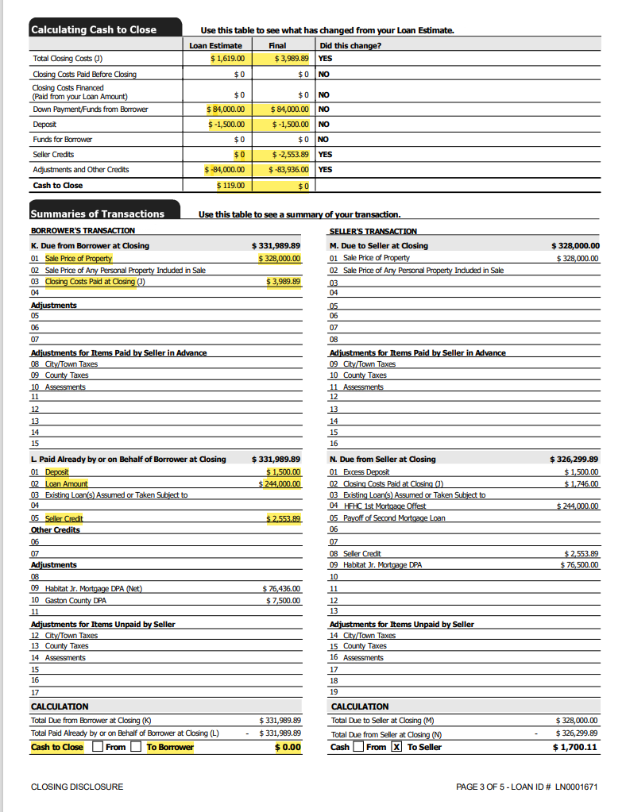
CLOSING DISCLOSURE

Slide 66

LEGAL DOCUMENTS
  Deed - The legal document conveying title to a property. The property is in your name; you own the property.
  Deed of Trust – The document used in NC to convey to a trustee rather than to the borrower. The lender has a security interest in the home until it’s paid in full.
  Don’t Pay, Don’t Stay!
  Promissory Note – The legal document obligating a borrower to repay a loan at a stated interest rate for a specified period of time with a specific monthly payment date.
Notes:
there may be additional documents/forms related to our programs that you may need to sign.

Slide 67
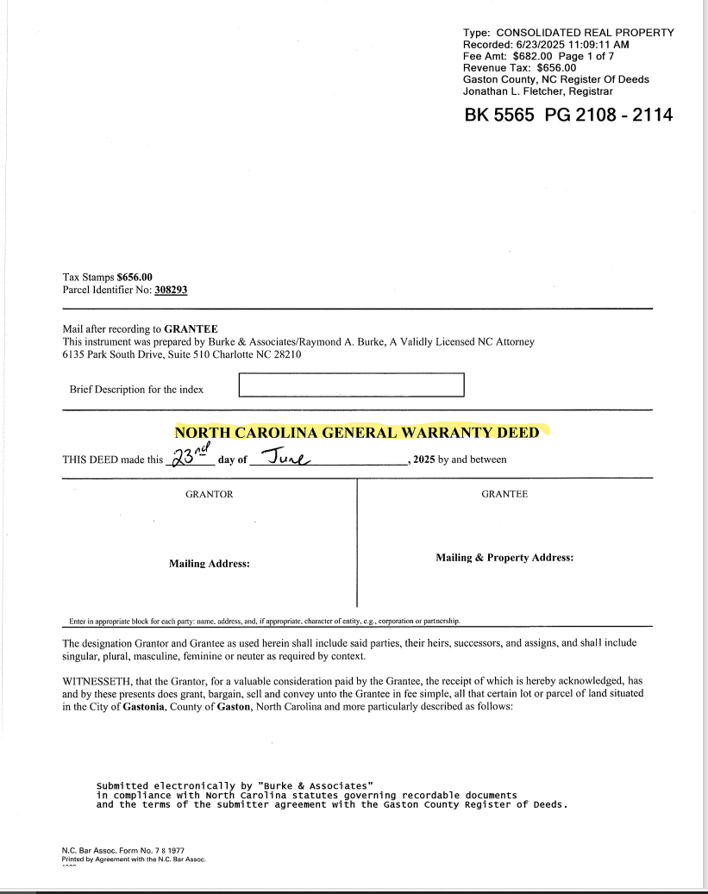
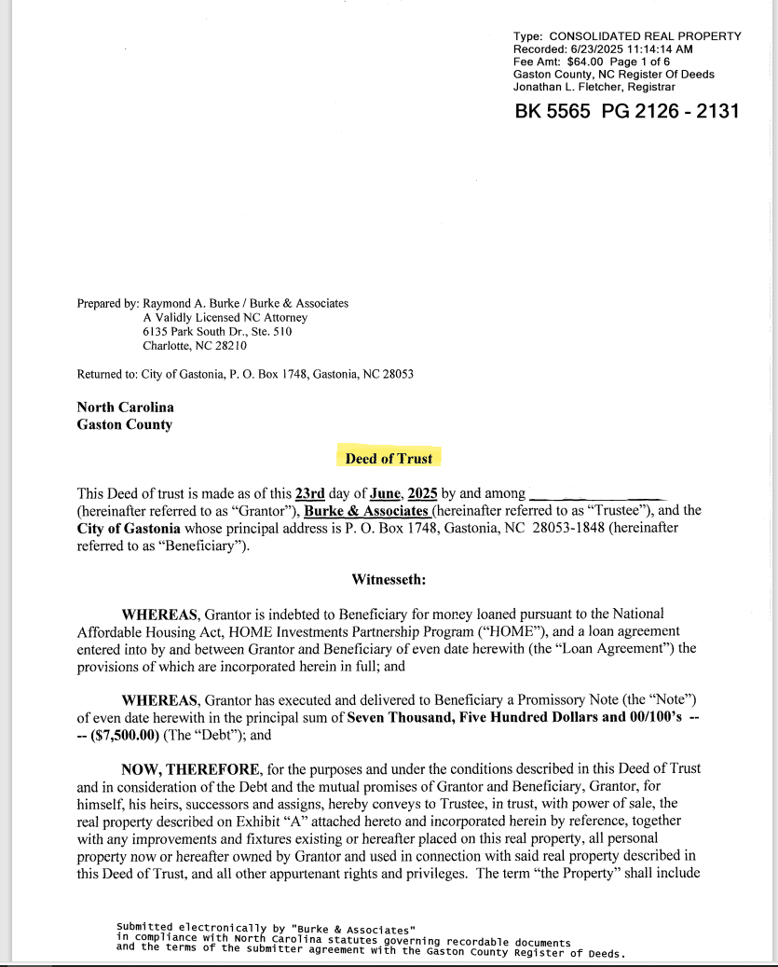
LEGAL DOCUMENTS
Your Name
Seller
Buyer
Notes:
there may be additional documents/forms related to our programs that you may need to sign.

Slide 68

The Final Process
1. After all the documents have been reviewed, properly signed and dated by you, the seller, lawyer and the lender.
2. Lawyer goes to courthouse to record the Deed and Deed of Trust.
3. Then it’s officially yours!!!

Slide 69

Congratulations!!
You are now a homeowner!
Now you must live in and maintain your home!

Slide 70

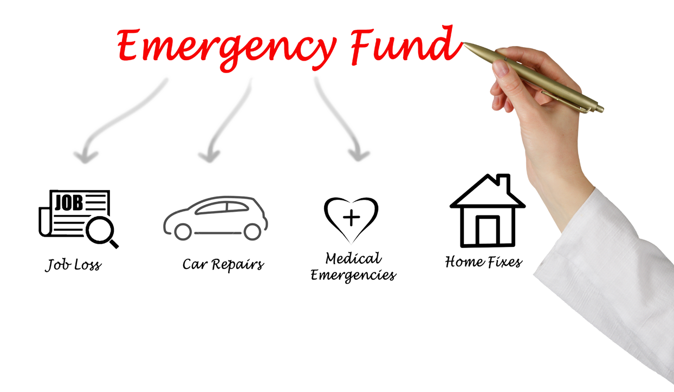
Maintaining your Home
  Mortgage payment is your top financial priority
Know where to send your payment
Know your payment due date
Know the impact of one extra payment
  Home Maintenance Allowance
  Emergency Reserve Fund
Notes:
1.- Be sure to pay your mortgage payment on time
every month!
2.- Budget 1% for home maintenance
(Example: $80,000 = $800/year)
3.- Establish a fund to cover emergencies that may
occur with your home

Slide 71

Home Maintenance
  Hammer
  Screwdrivers – flat head and Phillips
  Pliers
  Wrench
  Drill
  Tape Measure
  Ladder – watch the size for your house (need to clean gutters and get on the roof)
  Flashlight (with extra batteries)
  Duct tape and an assortment of other tapes/glues
The Basics
Notes:
You may want to consider obtaining a fireproof box
Safe Deposit Box

Slide 72



MAINTENANCE
Do-It-Yourself repairs are a great way to SAVE!
Things to think about:
  Cleaning out gutters
  Changing filters
  Yard upkeep
  Servicing heating cooling system
Things to consider when you are a homeowner:
  Lawn and garden equipment
    lawn mowers, hoses, clippers, shovels, rakes, etc.
  Pest Control
  Power Tools
  Appliances
  Trash cans
  New and higher bills for utilities.

Slide 73


INVEST IN YOUR
NEIGHBORHOOD
  Become involved in your community
  Get to know your neighbors
  Volunteer
  Read community newspapers or list serves
  Clean up trash you see around
  Call the City if your neighbors aren't taking care of their property.

Slide 74


HOME SAFETY -
Theft Prevention
  Change door locks or have locks re-keyed
  Lock doors and windows when leaving home
  Stop newspaper delivery and mail when out of town
  Alert trusted neighbors

Slide 75



HOME SAFETY -
FIRE
  Have at least two extinguishers per home
    (one per floor in larger homes)
  Always have one in the kitchen
  Have one in the main living area
  Exiting house from second story?
Notes:
FIRE DETECTORS
Check at least twice a year
Install inside each bedroom door
Install one near the living room
FIRE DRILLS
Conduct with family members
Designate Exits
Designate a meeting spot away from home

Slide 76

Financial Trouble??
There are several foreclosure prevention, or workout, options that the lender can use to help you keep your house while you get over the hardship, such as a payment plan, forbearance, loan modification, and Partial Claim
Call your lender and speak with a delinquency counselor to discuss your options.

Slide 77

CONTACT US
150 S. YORK ST GASTONIA, NC 28052
GARLAND BUILDING 2ND FLOOR
Lauretta Gordon - 704-854-6602
lauretta.gordon@gastonianc.gov

Slide 78


